Slide 1
Comparison of DS, ML, DL and AI
Version 1.0
August 2021

Slide 2
Agenda
Introduction
What is Data Science?
What is Machine Learning?
What is Deep Learning?
What is Artificial Intelligence?
Comparing DS, ML, DL and AI
Summary

Slide 3
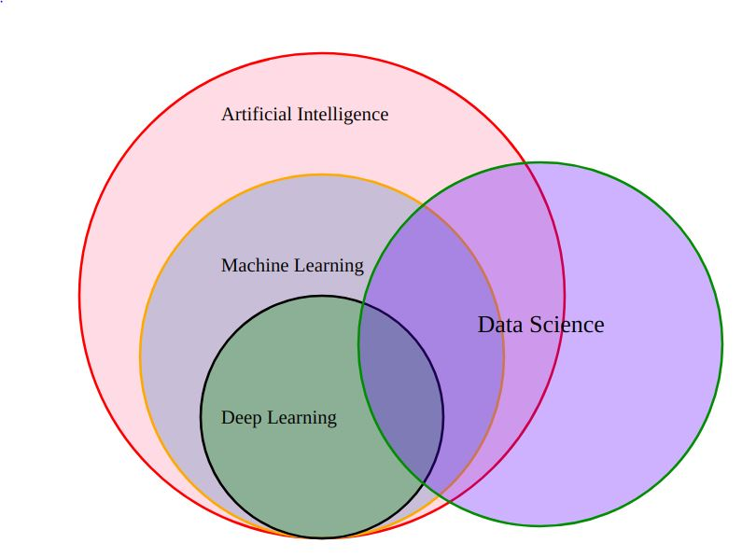
Introduction (1/2)
As a part of digital innovation strategy, healthcare companies and developers across the world are embracing Data Science (DS), Machine learning (ML), Deep Learning (DL) and Artificial Intelligence (AI)
All these acronyms/names are often used loosely in the field of technology and healthcare business to gain meaningful insights out of data. These insights are then used for effective decision making and process optimization
Though each of these four disciplines can utilize the same healthcare data, they differ in terms of the data processing, underlying processes to gain the insights and the process of decision making or recommendations
https://user-images.githubusercontent.com/7995307/64065525-153d9580-cbfe-11e9-9236-d9ffc3f34a43.png
Venn Diagram illustrating coverage of Data Science, AI, ML, DL

Slide 4
Introduction (2/2)
Data Science:
Data science is the field of applying advanced analytics techniques and scientific principles to extract valuable information from data for business decision-making, strategic planning and other uses.
Example: Identification and prediction of disease, healthcare recommendations.
Machine Learning:
Machine learning is set of techniques to make computer better at doing things that humans can do better then machine. ML is a type of AI that enables machines to learn from data and deliver predictive models.
Example: Traffic Prediction, Image and Speech Recognition, Chatbot (Online Customer Support)
Deep Learning:
Deep learning is a class of machine learning algorithms that uses multiple layers to progressively extract higher-level features from the raw input.
Example: Face Recognition, Virtual assistants (Alexa or Siri)
Artificial Intelligence :
Artificial Intelligence (AI), the ability of a digital computer or computer-controlled robot to perform tasks commonly associated with intelligent beings.
Example: Self-driving cars

Slide 5
Agenda
Introduction
What is Data Science?
What is Machine Learning?
What is Deep Learning?
What is Artificial Intelligence?
Comparing DS, ML, DL and AI
Summary

Slide 6
What is Data Science? (1/4)
Data Science:
Data science is a deep study of the massive amount of data, which involves extracting meaningful insights from raw, structured, and unstructured data that is processed using the scientific method, different technologies, and algorithms.
Data science uses the most powerful hardware, programming systems, and most efficient algorithms to solve the data related problems. It is the future of artificial intelligence.
Data Science Is All About:
Example:
Let suppose we want to travel from station A to station B by car. Now, we need to take some decisions such as which route will be the best route to reach faster at the location, in which route there will be no traffic jam, and which will be cost-effective. All these decision factors will act as input data, and we will get an appropriate answer from these decisions, so this analysis of data is called the data analysis, which is a part of data science.
Asking the correct questions and analyzing the raw data.
Modeling the data using various complex and efficient algorithms.
Visualizing the data to get a better perspective.
Understanding the data to make better decisions and finding the final result.

Slide 7
What is Data Science? (2/4)
Data Science in Healthcare
Decision Support Systems:
Decision support systems are computers that take a patient’s entire medical history, current symptoms, and other data, then analyze it using a series of complex algorithms. Based on this analysis, decision support systems are then able to make a diagnosis that physicians can use to back up their own diagnosis.
Augmentation Of Workflows:
Data Science helps in advancing healthcare facilities and processes. It helps boost productivity in diagnosis and treatment and enhances the workflow of healthcare systems. The ultimate goals of the healthcare system are as follows:
To ease the workflow of the healthcare system
To reduce the risk of treatment failure
To provide proper treatment on time
To reduce the waiting time of patients
Use Cases Of Data Science In Healthcare:
Drug Discovery
Diagnostics
Reduced Healthcare Costs
Predictive Analytics
Monitoring Patient Health
Medical Image Analysis

Slide 8
What is Data Science? (3/4)
Data Science Use Case: Wearables
Wearables have recently become quite popular and ubiquitous among masses, which include smart-watches, fitness trackers, smart clothing, implantable and others. These are worn on the body to gain vital readings of individual’s health like heart rate, blood pressure, temperature and others
Objective
To record the important information related to patient health that is stored in the cloud for analytics
The captured data is utilized to create predictive models for prediction of adverse health events, prevention of diseases and for efficient health management

Slide 9
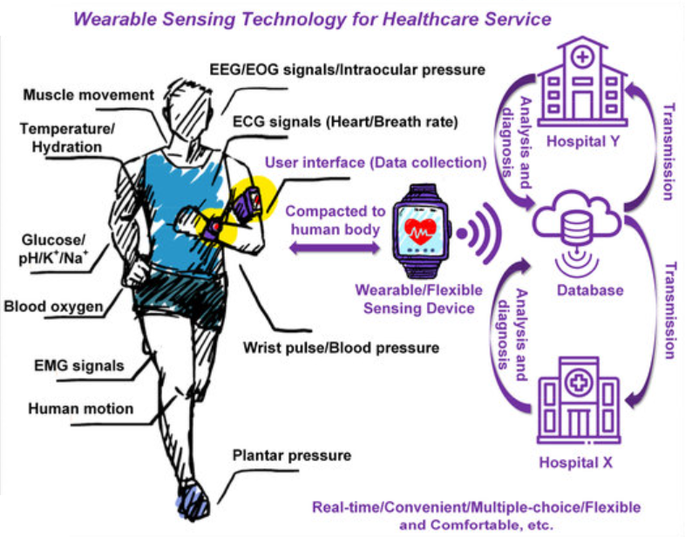
Data Science example use case – RPM (4/4)
Applications
With remote patient monitoring, wearables record vital health readings that are used to formulate a data science model
It enables personalization and provide incentives to individual’s health
It keeps track of individual health status and regulate risks associated with it
It allows analyst to determine patterns to predict potential health issues for early diagnosis
https://www.researchgate.net/publication/329728601_Non-Invasive_Flexible_and_Stretchable_Wearable_Sensors_With_Nano-Based_Enhancement_for_Chronic_Disease_Care

Slide 10
Agenda
Introduction
What is Data Science?
What is Machine Learning?
What is Deep Learning?
What is Artificial Intelligence?
Comparing DS, ML, DL and AI
Summary

Slide 11
What is Machine Learning? (1/4)
Machine learning is a field of computer science that uses statistical algorithms to teach computers how to learn/extract patterns from the data and act without being explicitly programmed
More specifically, it is an approach to data analysis that involves building and adapting models, which allow programs to "learn" through experience
Machine learning involves the construction of algorithmic models to improve the ability of machines to make appropriate predictions
Machine Learning algorithms can be classified as depicted below:
Supervised
Maps input parameters to target variable (labeled)
Unsupervised
Only input data is available (unlabeled)
Semi-supervised
Small labeled and large unlabeled data
The model is trained on pairs of input and output parameters
Then, model is utilized for future prediction
Examples
House price prediction
Image Classification
The model is trained by identifying patterns of EDA
Goal is to understand underlying structure/distribution of data
Examples
Customer Segmentation
Drug discovery
This combination possesses benefits of both models
Improves learning accuracy of the model
Examples
Lane-finding on GPS data
Classifying Radiology/report
Reinforcement
Agent interacts with environment for decision making
The model works on 3 concepts: state, action and reward
Agent receives a reward for each performed task
Examples
Chess game
Dynamic Treatment Regimes

Slide 12
What is Machine Learning? (2/4)
Machine Learning Process:
Collection of Data: Data collection from different sources could be internal and/or external to satisfy the business requirements/problems. Data could be in any format. CSV, XML.JSON, etc.
Data Processing (EDA) and Featured Engineering: Cleaning the data to remove unwanted data, missing values, rows, and columns, duplicate values, data type conversion, etc. Visualize the data to understand how it is structured and understand the relationship between various variables and classes present.
Choosing a Model: A machine learning model determines the output you get after running a machine learning algorithm on the collected data. It is important to choose a model which is relevant to the task at hand.
Training the Model: Training is the most important step in machine learning. In training, you pass the prepared data to your machine learning model to find patterns and make predictions.
Model Evaluation: After training your model, you have to check to see how it’s performing. This is done by testing the performance of the model on previously unseen data.
Parameter Tuning: If the evaluation is successful, we proceed to the step of hyperparameter tuning. This step tries to improve upon the positive results achieved during the evaluation step. At a particular value of your parameter, the accuracy will be the maximum. Parameter tuning refers to finding these values.
Making Predictions: In the end, you can use your model on unseen data to make predictions accurately.
Use Case of Machine Learning:
Amazon providing suggestions
Predict glucose Hyperglycemia event for diabetic patient
Email Monitoring
Medical image recognition of area of lesions

Slide 13
What is Machine Learning? (3/4)
Finding Patterns
Further, an ability to recognize new patterns by utilizing an existing trained model is known as generalization, which is one of the main objectives for pattern recognition
As it is known, data/information can be ambiguous, noisy or incomplete at times, due to which, pattern recognition becomes a difficult task. This gives rise to uncertainty
Following are some of the concepts to overcome such problems in pattern recognition:
Probability Theory
Decision Theory
Information Theory
Each of these theories1 provide a framework that quantifies and manipulate the data to handle the uncertainty, which allows us to optimize the predictions from all the available information for pattern recognition
Gather data
Identify similarities
Segregate data in groups
Analyze each group
Gather data
Clean data
Identify similarities
Segregate data in groups
Analyze each group
Infer insights
Clean data
Pattern Recognition Process in ML

Slide 14
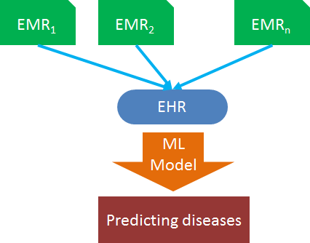
What is Machine Learning? (4/4)
Machine Learning Use Case: Predicting Heart Failure using EMR
Objective
The Heart failure prediction using machine learning techniques
Procedure
The initial procedure for this problem is the collection of data. We have collected the data set from EMR (Electronic medical records). The various attributes are given like Age, Sex, Cp, Trestbps, Chol, Fbd, Ca, Slope etc.
The next step after data collection is data pre-processing. In this step, the data is cleansed by removing unnecessary values. It also removes the missing/ null/ corrupted values.
After Data is cleansed, the next step is dividing the data, we divide the data into two sets, Training data and testing data. The values must dealt before we start to construct the training model. By using training data, we build a model for prediction.
We apply few algorithms and chose algorithm who gives more accuracy. Now, we must calculate the accuracy of the model.
The final step is predicting the disease. The final output will be in numerical 1= Yes; 0= No.
https://healthitanalytics.com/news/machine-learning-tracks-ehr-data-to-predict-disease-risk

Slide 15
Agenda
Introduction
What is Data Science?
What is Machine Learning?
What is Deep Learning?
What is Artificial Intelligence?
Comparing DS, ML, DL and AI
Summary

Slide 16
What is Deep Learning? (1/3)
Deep Learning (DL) is a subset of machine learning, which uses artificial neural networks, that imitates the structure and functioning of the human brain to predict outcome(s) based on the information processed in the intermediary layers
A network of neurons, either arranged as network in layers with forward or backward signal propagation with delays, etc., mimic human brain signal, information and knowledge management.

Slide 17
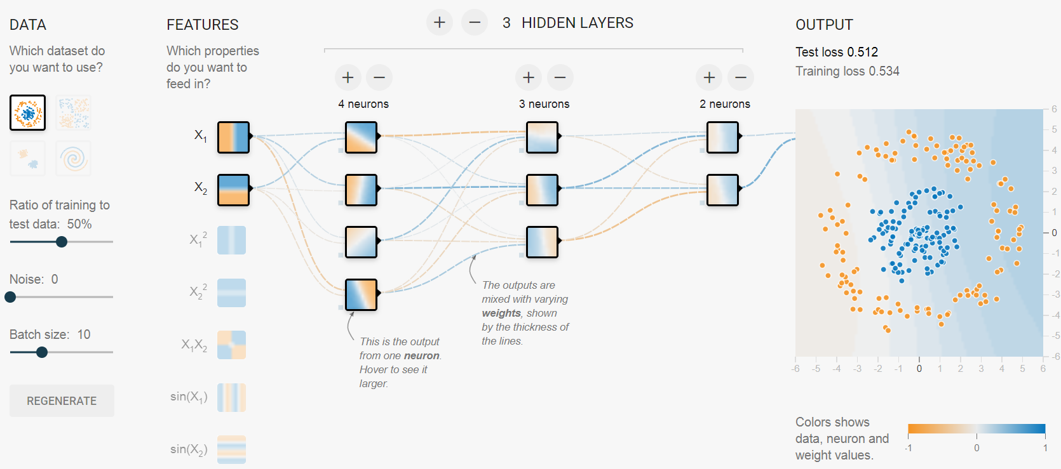
What is Deep Learning? (2/3)
When neurons are arranged in multiple layers with specific connectivity pattern between neuron of one layer to neuron in other layer we obtain neural network.
Deep Learning network consists of large number of layers of neurons between input and output layer.
https://playground.tensorflow.org/

Slide 18
What is Deep Learning? (3/3)
Deep Learning Use Case: Imaging analytics and diagnostics
Deep learning techniques helps in uncovering related diseases by analyzing the images and classifying them on various parameters. The diagnosis of these type of diseases could range from small injury like a hairline fracture to acute problems like various types of cancer or others.
Objective
Convolutional neural networks (CNNs) is a DL algorithm utilized to examine and classify images
It extracts the high-level features such as edges and with add-on layers, it augments the features
It provides us a network having comprehensive understanding of images

Slide 19
Agenda
Introduction
What is Data Science?
What is Machine Learning?
What is Deep Learning?
What is Artificial Intelligence?
Comparing DS, ML, DL and AI
Summary

Slide 20
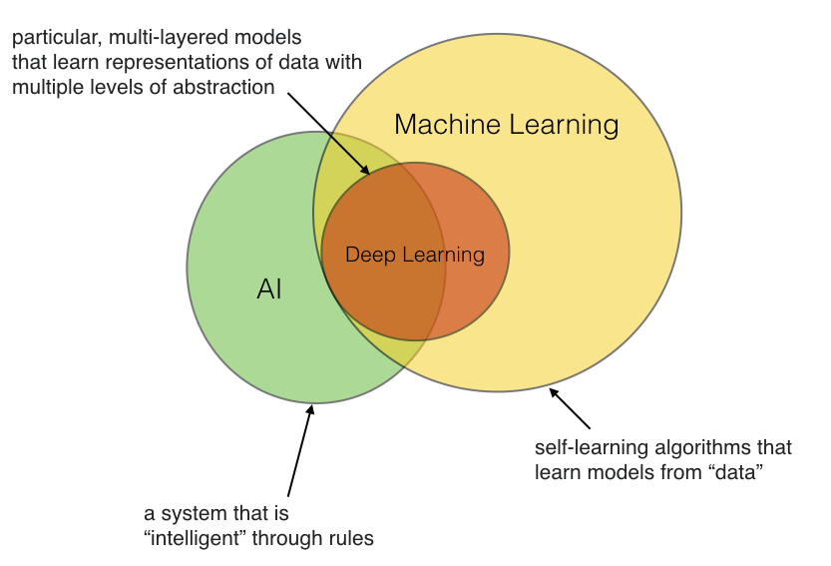
What is Artificial Intelligence? (1/4)
Artificial intelligence (AI) is the ability of a machine or a computer program to perceive, think, learn and act like humans
Additionally, a feedback loop goes with learning and acting by interactively querying the information for the desired output. This is called as active learning
Further, with the help of active learning, AI can achieve better accuracy that help in making the auto-corrections to its predictions over a timeframe
AI is accomplished by studying how human brain thinks, acts and learns while trying to solve a problem, and then using the outcomes of this study, intelligent software and systems are developed
AI supersedes the other disciplines that eventually encompasses everything in making smarter machines/technologies
Relationship Between Artificial Intelligence And Machine Learning: They are related inherently, but this doesn't mean that they are synonymous. AI is the parent of ML. Artificial Intelligence is the concept of creating smart intelligent machines. Machine Learning is a subset of artificial intelligence that helps you build AI-driven applications.
Use Cases Of AI:
Self-driving cars
Medical Imaging and Diagnostic
Healthcare Management
Client Sentiment Analysis
Drug discovery
https://sebastianraschka.com/images/faq/ai-and-ml/ai-and-ml-1.png

Slide 21
What is Artificial Intelligence? (2/4)
Perceive Think Learn Act
This is a simple minimal strategy that humans use to reason, decide, choose, acquire knowledge, gain experience, and ultimately try to automate logical approaches to a modelled system
With little more sophistication, AI studies and develops theories, methods, techniques and application systems for simulating, and extending human intelligence.
Feedback loop
In AI, feedback loop is essentially a reinforcement learning, which is an applied technique of machine learning
It helps in taking appropriate actions by auto-correcting with cumulative rewards. Some of the examples of feedback loop-reinforcement learning are
Virtual nursing assistants
Robotic surgeries
AI process
Perceive
Think
Learn
Act
Feedback

Slide 22
What is Artificial Intelligence? (3/4)
Perceive Think Learn Act
AI technologies are classified based on their capacity to mimic human characteristics, the technology, their real-world applications, and the theory of mind
Using these characteristics as reference, all AI systems are classified either based on their capabilities or functionalities
Types of AI
Based on Capability
Based on Functionality
Reactive Machines
Narrow AI
Limited Memory
General AI
Theory of Mind
Strong AI
Self Awareness

Slide 23
What is Artificial Intelligence? (4/4)
AI Parts In The Robotics Surgery
AI can determine patterns within surgical procedures to improve best practices and to improve a surgical robots’ control accuracy to submillimeter precision.
Designed to assist during operations with surgical instruments' manipulation and positioning, AI-driven surgical robots are computer-manipulated devices that allow surgeons to focus on the complex aspects of a surgery.
AI is also being used with machine vision to analyze scans and detect cancerous cases. Laparoscopic video analysis of surgeries, like sleeve gastrectomy procedures, helps to identify missing or unexpected steps in real time.
AI Parts In The Human Robot
Artificial Intelligence gives robots a computer vision to navigate, sense and calculate their reaction accordingly. Robots learn to perform their tasks from humans through machine learning which again is a part of computer programming and AI.
Sophia: This is the world's first robot citizen. She was introduced to the United Nations on October 11, 2017. On October 25th, she was granted Saudi Arabian citizenship, making her the first humanoid robot ever to have a nationality.
Surgical Robotics
Requirements: precision, robustness, real time, safety
Challenges: accurate kinematics and dynamics modelling, perception of the dynamic environment, high autonomy
Sub-areas: robotic perception, localization and mapping, system modelling and control, human-robot interaction

Slide 24
Agenda
Introduction
What is Data Science?
What is Machine Learning?
What is Deep Learning?
What is Artificial Intelligence?
Comparing DS, ML, DL and AI
Summary

Slide 25
Comparing DS, ML, DL and AI
AI vs ML vs DL vs DS Comparison Model
ML
Cleansing
Preparing
Model building
Evaluation
ML
Prediction
Data
DL
Feature extraction
Grouping
Evaluating
Improving
DS
Storing
Cleaning and munging
Describing
DS
Providing
Insights
DL
Predication
AI
Learning
Knowledge
Interference
Decision
AI
Interaction
Big data
Input
Process
Output
Note: Although, this picture has separate sections in the processes involved in each discipline, each of them overlap as described in the first slide of the comparison section

Slide 26
Agenda
Introduction
What is Data Science?
What is Machine Learning?
What is Deep Learning?
What is Artificial Intelligence?
Comparing DS, ML, DL and AI
Summary

Slide 27
Summary
The information presented in this CPD attempts to provide basic introductory understanding of data science, machine learning, deep learning and artificial intelligence. It illustrates the application of these techniques in the recent COVID crisis
Then, it exemplifies each of the disciplines by providing their general definitions along with explanation of the underlying characteristics and concepts of the respective fields and it also illustrates the case study scenarios within the healthcare domain
Continuing the progress, the CPD tries to compare these 4 pillars on grounds of the Input, underlying processes and their corresponding Outputs. Comparison uses each of these techniques as reference to suggest the commonalities between them
Gradually, it can be observed that ML, DL and AI develop the functional solution using their own methodologies, and DS techniques are respectively applied to each disciplines depending on the problem statement. Thus, DS covers the entire spectrum of data processing and analysis
And, on the other end, AI is the future. AI provides an ability to undertake appropriate actions based on the knowledge gained from learning models which is the goal of an application

Slide 28
Thank You
ct-univerct@citiustech.com

